Slide 1
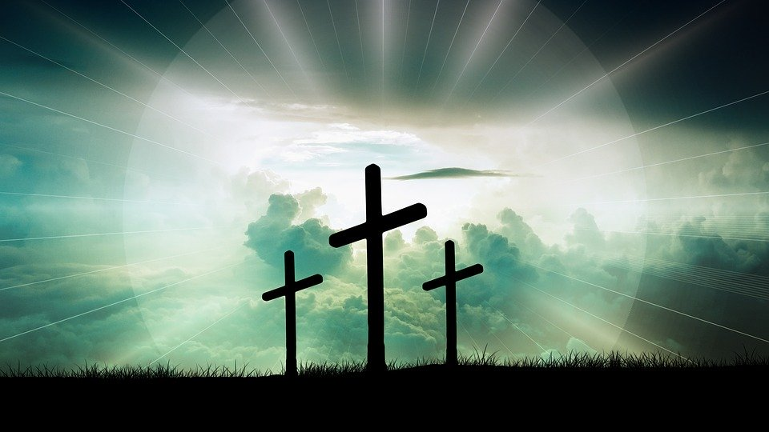
Who Is This Man?
Who Is This Man?
Colossians 1:15-18

Slide 2
Who Is This Man?
He is the Reflection of God V. 15a
John 1:1,14,18
Heb. 1:3
John 14:9

Slide 3
Who Is This Man?
He is the Reflection of God V. 15a
2. He is Lord of All Creation V. 15b-16

Slide 4
Who Is This Man?
He is the Reflection of God V. 15a
2. He is Lord of All Creation V. 15b-16
3. He is the Eternal Lord V. 17a

Slide 5
Who Is This Man?
He is the Reflection of God V. 15a
2. He is Lord of All Creation V. 15b-16
3. He is the Eternal Lord V. 17a
4. He Holds All Things Together V. 17b

Slide 6
Who Is This Man?
He is the Reflection of God V. 15a
2. He is Lord of All Creation V. 15b-16
3. He is the Eternal Lord V. 17a
4. He Holds All Things Together V. 17b
5. He is Head of the Church V. 18a

